Slide 1
Big Mountain Resort

Slide 2
Problem Identification
Big Mountain has added a new chair lift to the ski park.
Big Mountain needs a pricing strategy to maximize the value for the ticket price.
Big Mountain needs to implement the best solution without undermining the ticket price.

Slide 3
Problem Statement
What is the best pricing strategy to capitalize on the facilities of the park in order to account for a $154,000 increase in operating costs without undermining value for the approximately 350,000 customers?

Slide 4
Recommendation and Key Findings
Ticket price is currently underpriced by at least $10.59, and may be increased by as much as $18.79
Add two acres of artificial snow making justifies $.50 increase in ticket price.
Add a 150 foot vertical_drop justifies $.50 increase in ticket price.
Reducing the number of runs by 3 to 5 will cut costs while maintaining margins.

Slide 5
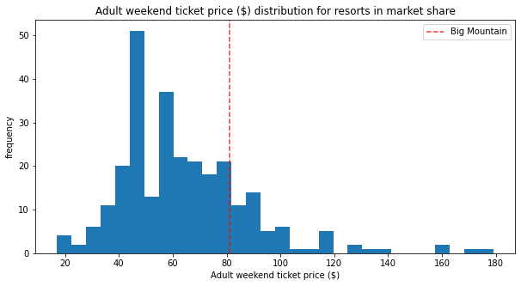
Modeling Results and Analysis
It appears the price for Big Mountain is set in the third quartile of the dataset, at $81.

Slide 6
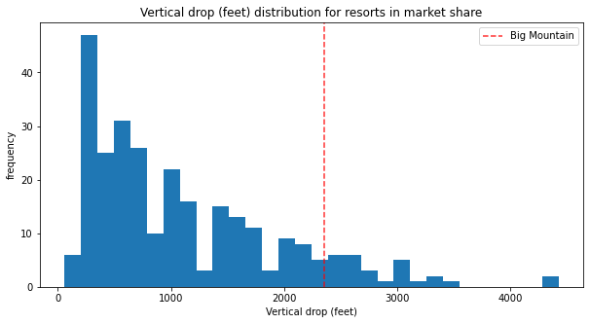
Modeling Results and Analysis
Big Mountain has more vertical drop footage than most resorts, but it looks like it can be more competitive in this category.

Slide 7
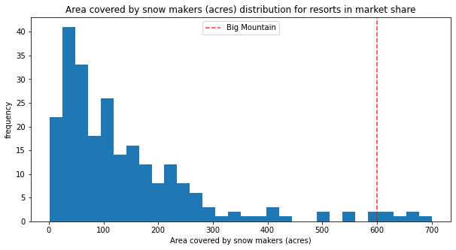
Modeling Results and Analysis
Big Mountain is amongst the leading snow makers in snow made per acre, but it is not the leader. There may be room for improvement.

Slide 8
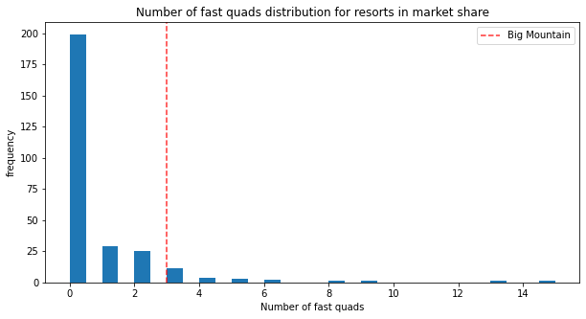
Modeling Results and Analysis
Big Mountain is doing pretty well as far as fast quads are concerned. There are some resorts that have more, but not many.

Slide 9
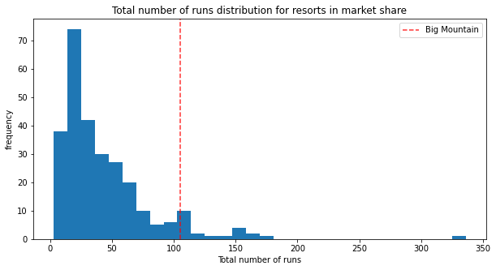
Modeling Results and Analysis
Big Mountain has a significant number of runs for its market share, but it could have more.

Slide 10
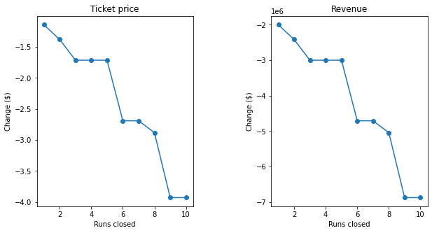
Modeling Results and Analysis
Reduce 1, no change in revenue.
Reduce 2, revenue reduced by .5
Reduce 3 – 5, no change in revenue

Slide 11
Summary and Conclusion
The Resort can increase Snow Making by two acres but will only be able to justify a $.50 increase in ticket price.
The company can increase the number of Fast Quads, but that will have a negligible effect on the ability to maintain profit margins.
Adding an additional 150 Vertical Drop will also only allow for a $.50 increase in ticket price.
Big Mountain can close down 1, or at lease 3 but no more than 5 runs while maintaining profit margins. Shutting down 2 will require sacrifice of some revenue.

